Slide 1
PLL as FM Demodulator Expt. No- 6

Slide 2
A Phase-Locked Loop (PLL):
A Phase-Locked Loop (PLL) is basically a negative feedback system. It consists of three major components such as re multiplier, a loop filter and a voltage controlled oscillator (VCO) connected together in the form of a feedback loop.
A VCO is a sine wave generator whose frequency is determined by the voltage applied to it from an external source. It means that any frequency modulator can work as a VCO.
A phase-locked loop (PLL) is primarily used in tracking the phase and frequency of the carrier component of an incoming FM signal.

Slide 3
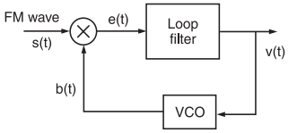
PLL
https://electronicspost.com/pll-fm-demodulator-phase-locked-loop-fm-demodulator/

Slide 4
Working:
If the signal fed back is not equal to the input signal, the error signal will change the value of the fed back signal until it is equal to the input signal.
The difference signal between s(t) and b(t) is called an error signal.
A PLL operates on a similar principle except for the fact that the quantity feedback is not the amplitude, but a generalized phase Φ(t).
The error signal or difference signal e(t) is utilized to adjust the VCO frequency in such a way that the instantaneous phase angle comes close to the angle of the incoming signal s(t).
At this point, the two signals s(t) and b(t) are synchronized and the PLL is locked to the incoming signal s(t).

Slide 5
Working:
VCO: A voltage controlled oscillator is an electronic oscillator whose oscillation frequency is controlled by a voltage input.
Phase detector: It multiply the incoming signal by the output of VCO.
LPF: Rejects the high frequency components.

Slide 6
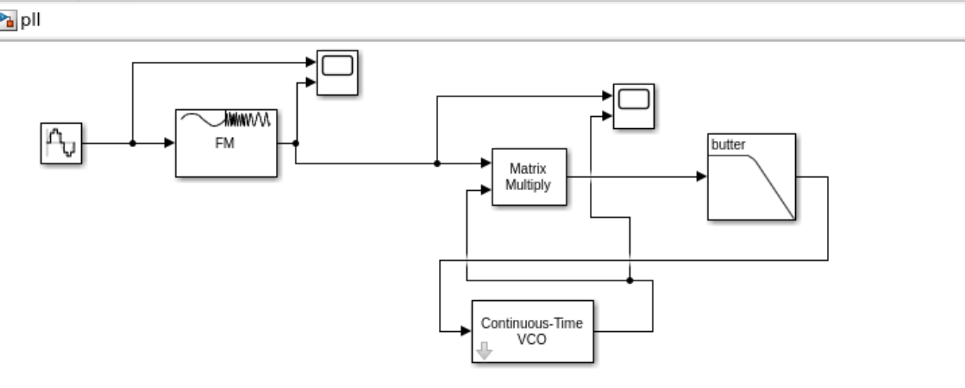
MATLAB Simulink:

Slide 7
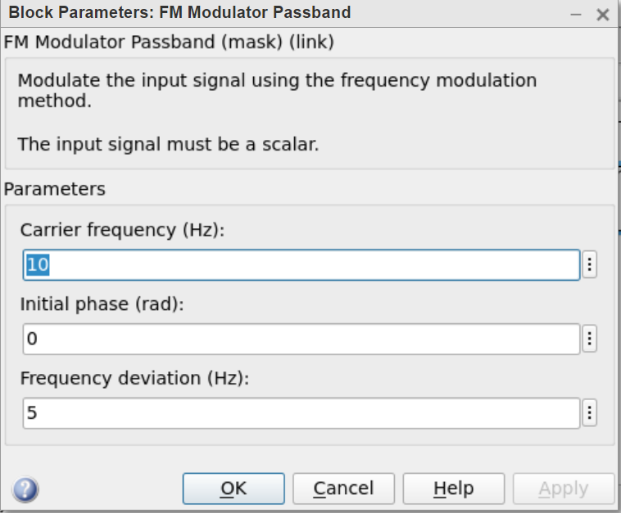
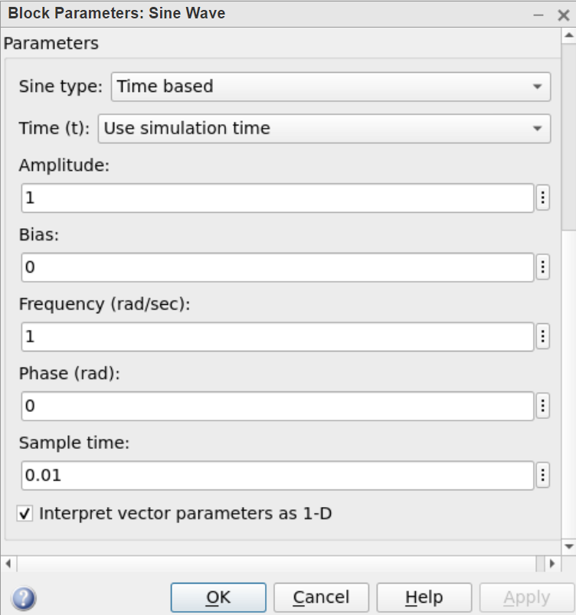
Different block Parameters:

Slide 8
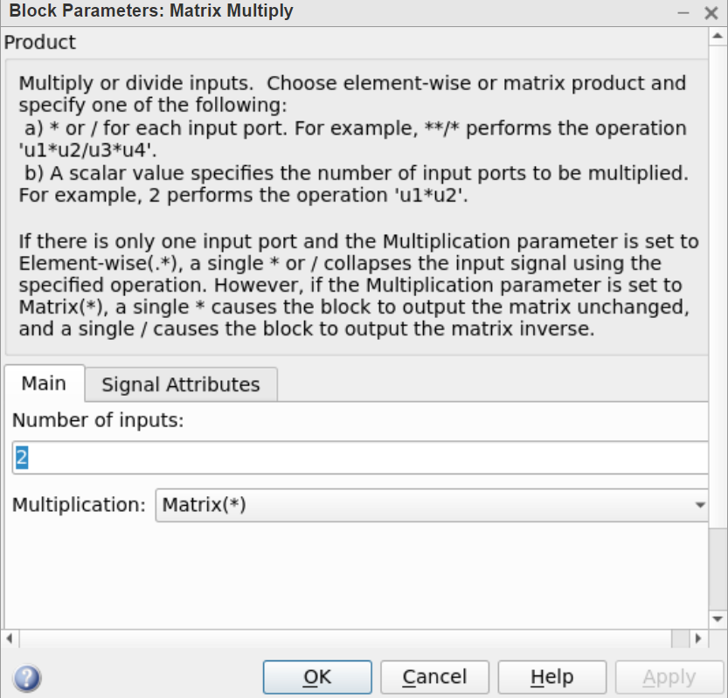
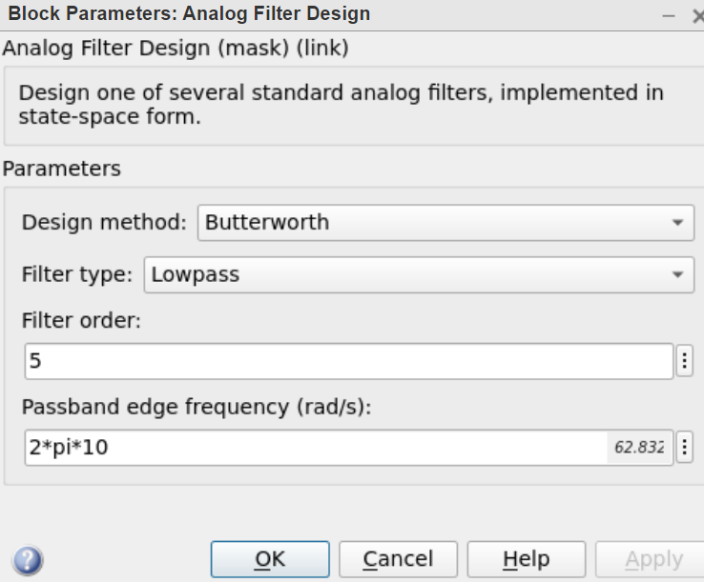
Block Parameter:

Slide 9
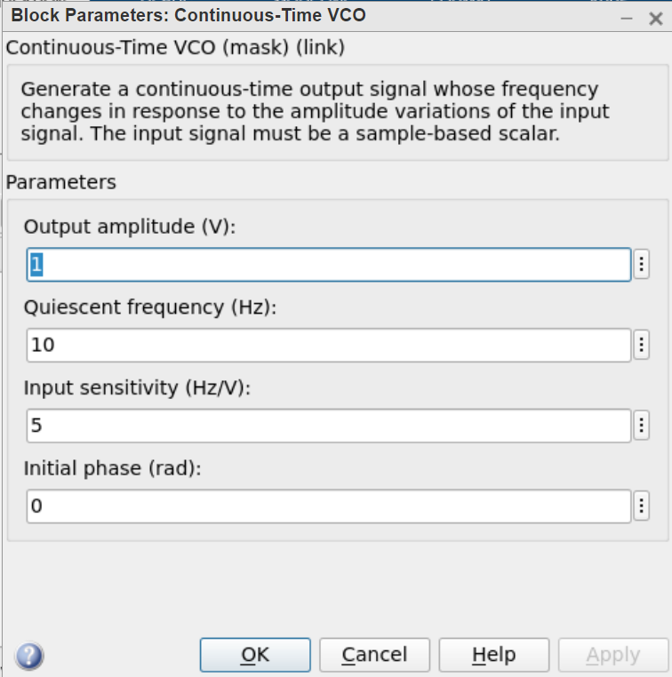
Block Parameter:

Slide 10
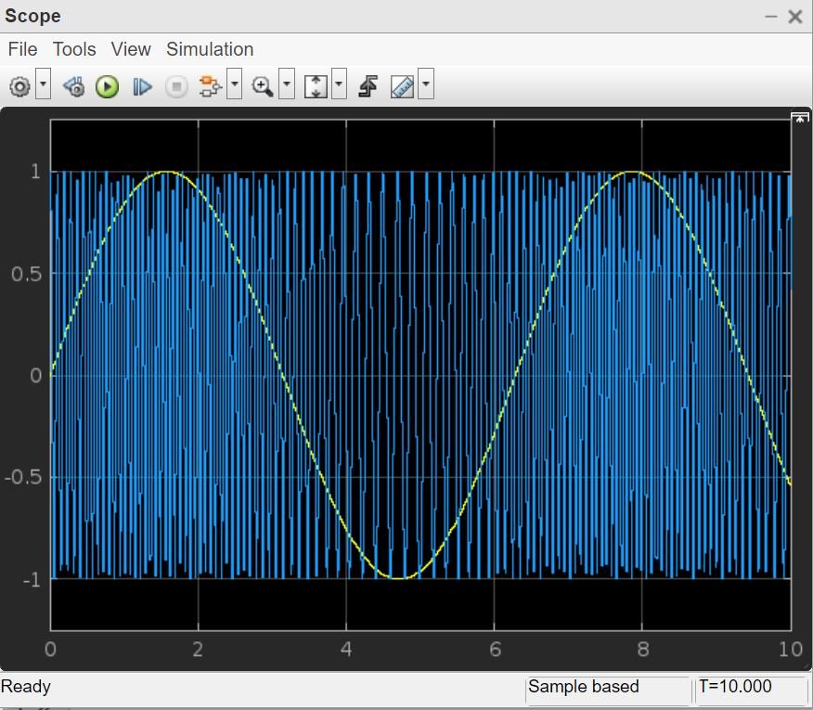
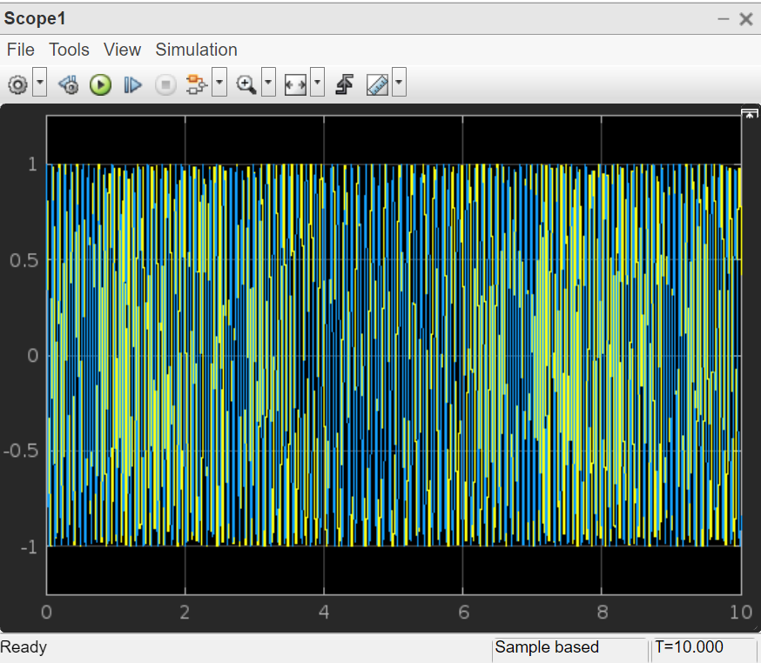
Output:

Slide 11
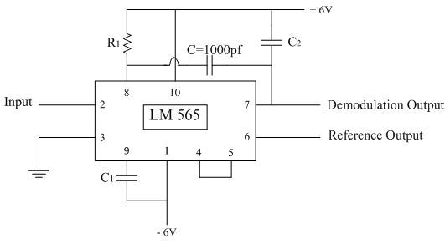
FM Demodulation: PLL

Slide 12
References:
[1] https://www.youtube.com/watch?v=aL2vo427zdY
[2] “B.P.Lathi”, Modern Digital and Analog Communication Systems Chapter 4.
[3] https://www.youtube.com/watch?v=d6ufJtyX6XA
[4] https://www.youtube.com/watch?v=kbbSJu6YV7Y
[5] https://www.youtube.com/watch?v=Ns3jJkX_tgA
[6] https://electronicspost.com/pll-fm-demodulator-phase-locked-loop-fm-demodulator/

